Slide 1


Inconvenient side of the food waste: Latvian NGO Green Liberty experience
Inga Belousa, PhD
Green Liberty
Project «Sincerely, Food»

Slide 2
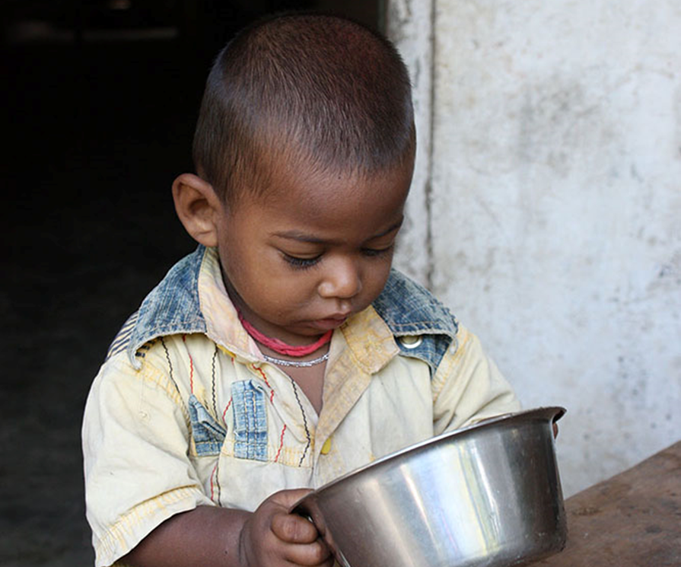
More than 1/3 or ~ 40 % of food produced for humans is wasted.
2.5 billion tonnes of around the world each year.
(WWF & TESCO, 2021)

Slide 3
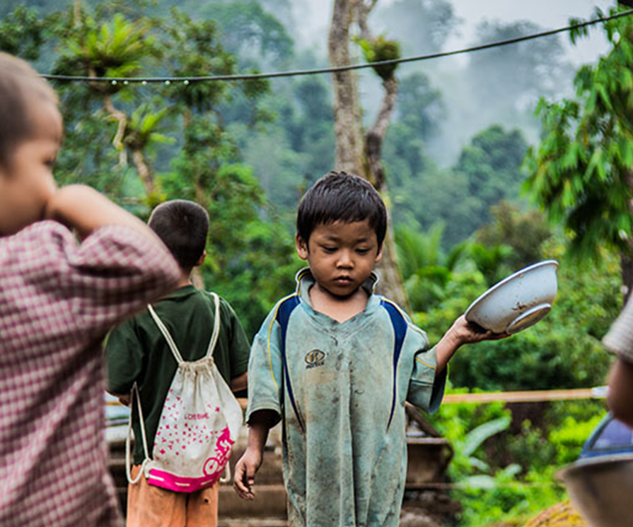
The amount of globally wasted food would be enough to feed 2 billion people – twice the number of those undernourished in the world,
that is 815 million of the world’s 7.7 billion people.
Cutting down food waste and using available food more effectively could improve food availability and food security in the world.

Slide 4
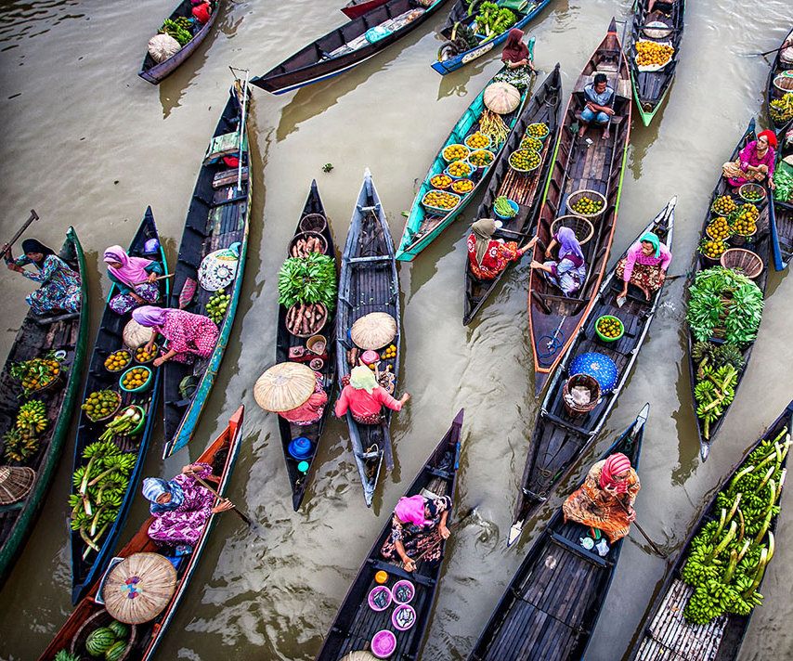
The largest amount of consumer food waste (per capita per year) is generated..
..in higher income countries (Europe, North America): post-consumption food waste.
In lower income countries, food is lost in agriculture, distribution, processing and transportation sectors.

Slide 5






Food waste in numbers
Global:
2.5 billion tonnes of food annually; of which in the poorest regions – 6-11 kg per capita
(WWF & TESCO, 2021)
EU:
88 million tonnes of food annually, or ~ 20 % of production, averaging 180 kg per capita and costing € 143 billion
(FUSIONS, 2016)
Local – LV:
an average of 113 kg of food waste per capita annually
(Ministry of Agriculture and LASA)

Slide 6

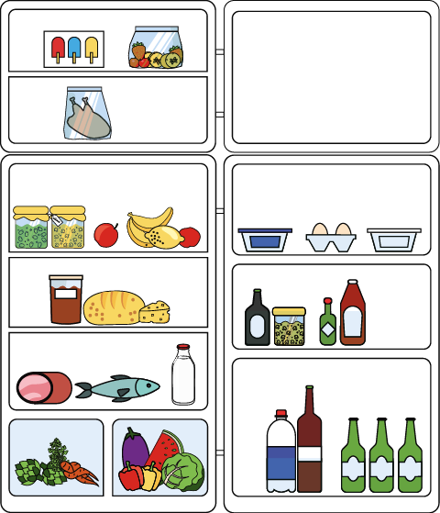

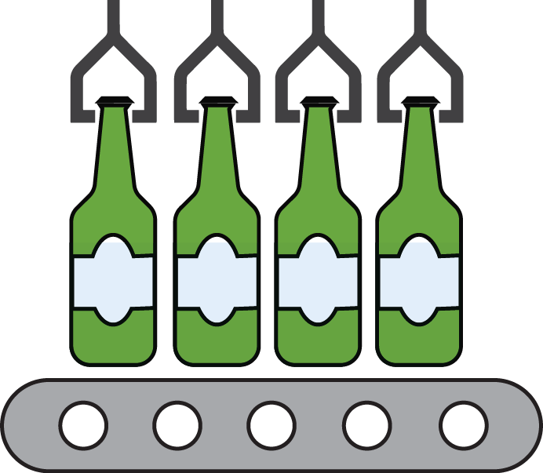
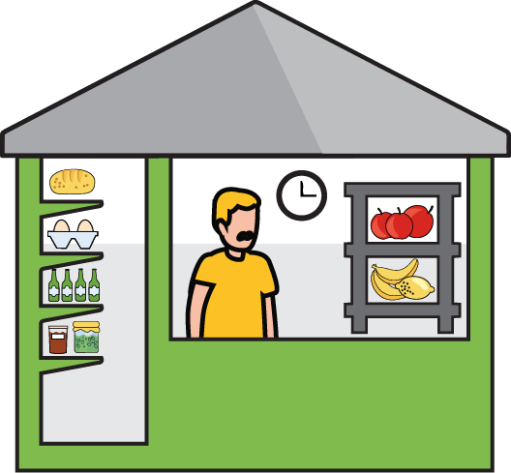




Global food supply chains
Food supply chains are long and globalized: food is grown in one place, processed in another and consumed in a third.
The consumer often does not know the producer, and the producers do not have any idea who their consumer is.
Fields
Storage
Food
Processor
Food Manufacture
Distributor
Retailer
Kitchen

Slide 7
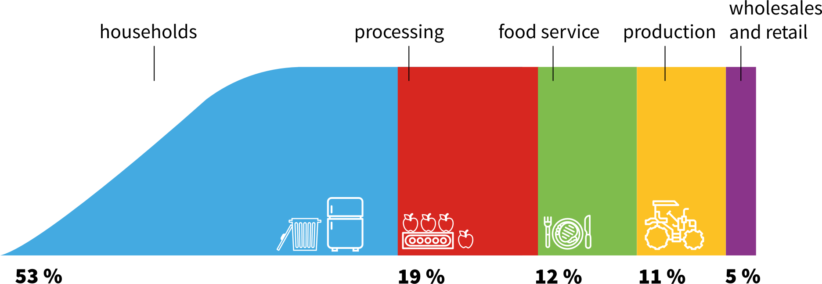
Where is the biggest amount of food wasted (in EU)?
47 mill. tones
(FUSIONS, 2016; Priefer et al., 2016)

Slide 8
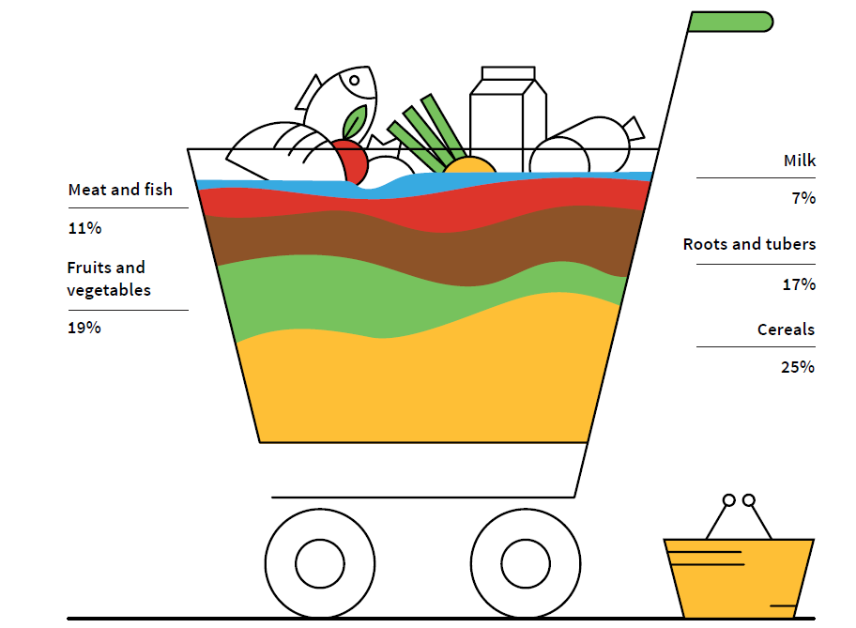
What is in the most wasted food basket?
(FAO, 2013)

Slide 9
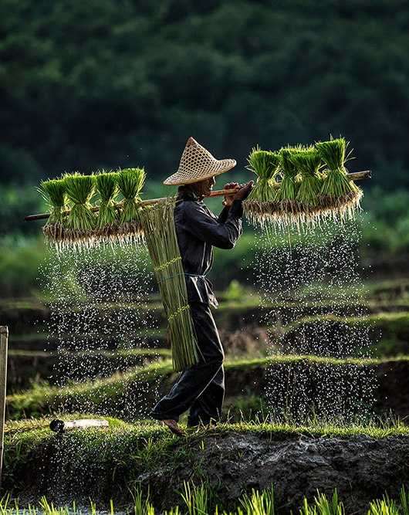
What is wasted with food waste?
Environmental quality:
  resources – water, energy, materials, land,
  air, water, soil and climate stability,
  biodiversity.
Social possibilities:
food security,
decent work,
well-being.
Economic possibilities: money.

Slide 10
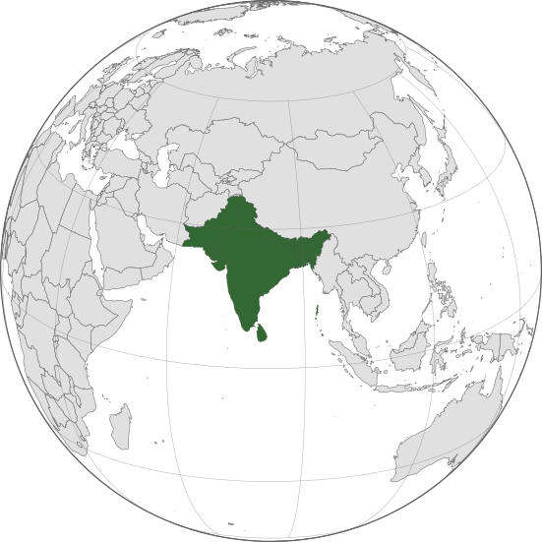
4.4 million km² of agricultural land and 760km³ of water are used to produce the 1.2 billion tonnes of food that are lost before, during and after harvest.
This equates to a landmass larger than the Indian subcontinent and water volume equivalent to 304 million Olympic swimming pools (50x25x2).
(WWF & TESCO, 2021)

Slide 11
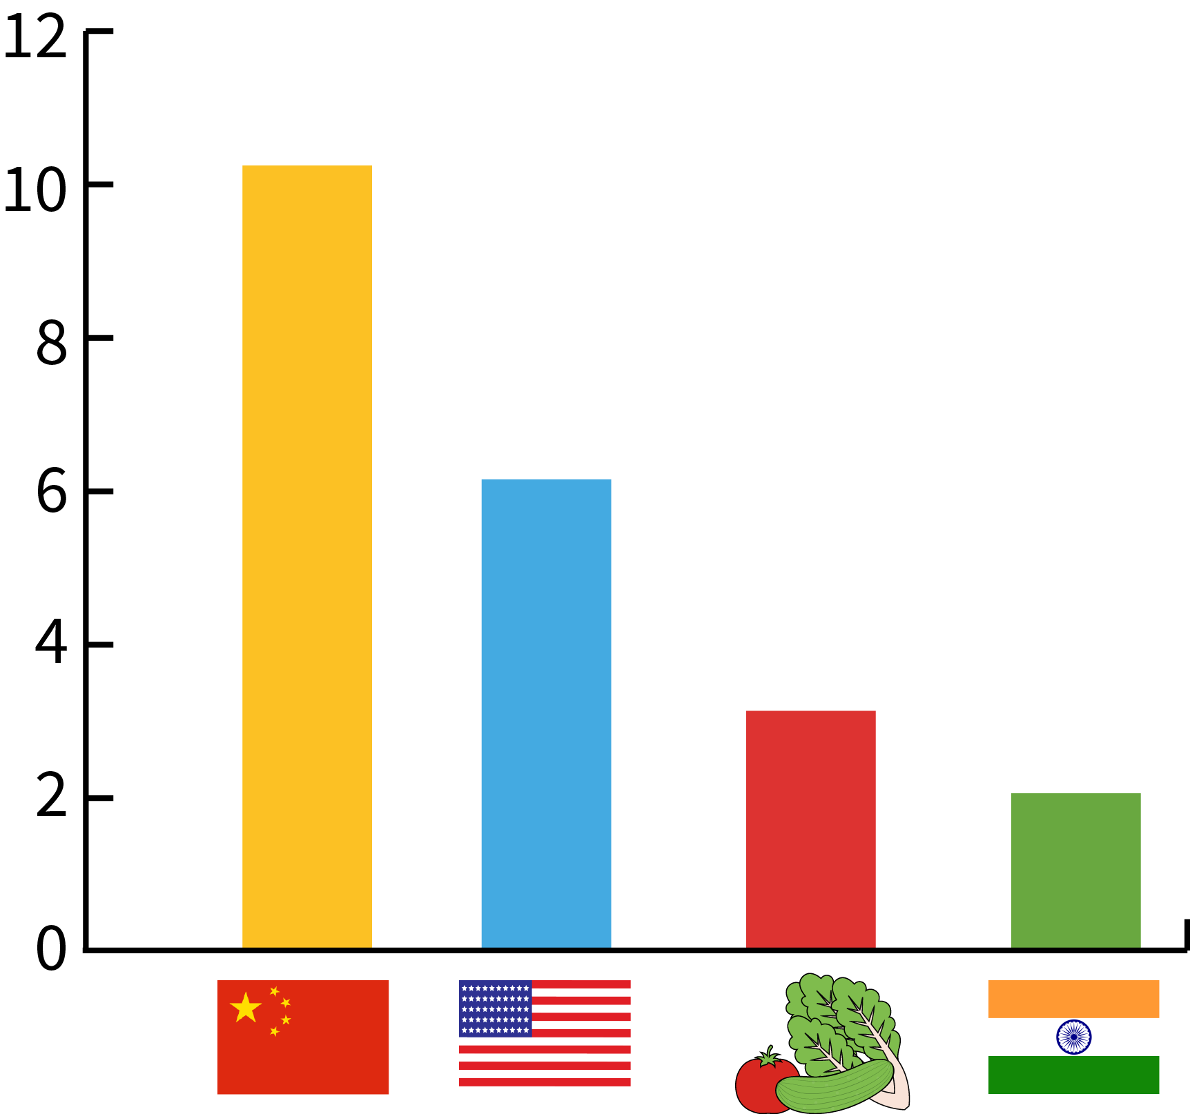
What are the impacts of food waste?
Environmental impacts: climate change and global warming
Bio-waste emits methane – a greenhouse gas 20 times more effective on climate change than carbon dioxide.
10% of all greenhouse gas emissions come from food waste. It represents 3 % of the EU's total greenhouse gas emissions.
If global food waste was a country, it would be the third largest greenhouse gas emitter after the US and China
billion tonnes CO2 equivalent
China
US
Food waste
India
(FAO, 2017)

Slide 12
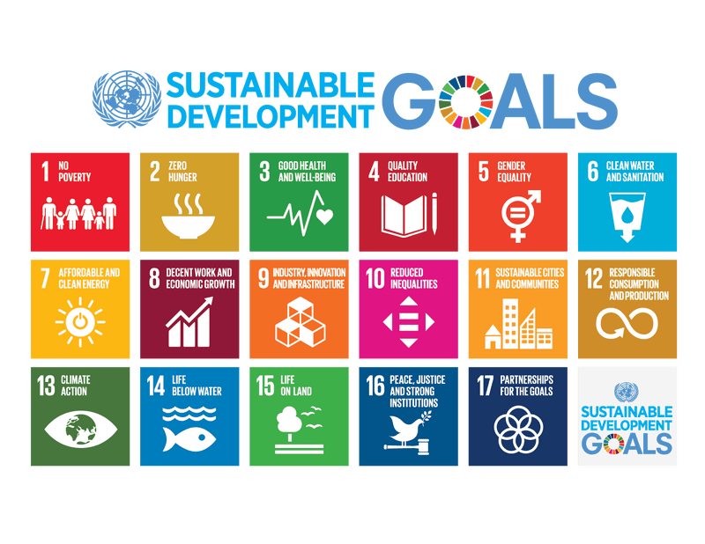

Policies and initiatives addressing food waste
SDG 12: sustainable consumption and production patterns
SDG 2: end hunger, achieve food security and improved nutrition and promote sustainable agriculture
SDG 13: combat climate change and its impacts
SDG 14 and SDG 15: sustaining life bellow water and on land

Slide 13

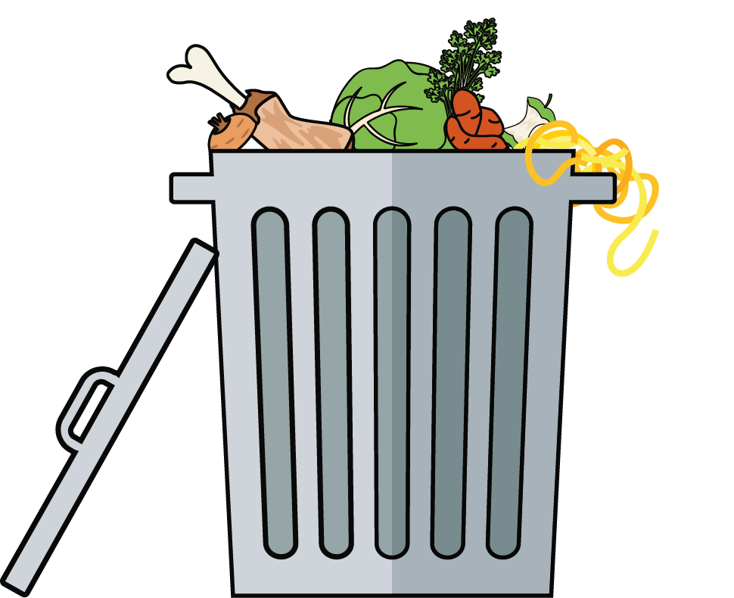
EU level policies addressing food waste
"Towards a circular economy: a zero-waste programme for Europe" (COM/2014/0398)
Directive 2018/851 amending Waste directive
Food waste reduction goal by 2030: reduce by 50% per capita

Slide 14

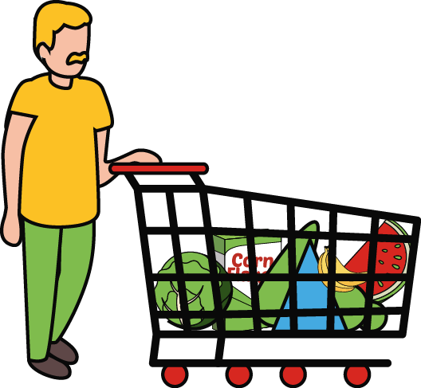



Tips & tricks to prevent food waste at home
Tip 1:
meal planning
Tip 2:
smart shopping
Tip 3: portioning
Tip 4:
smart storage
Tip 5:
re-using leftovers

Slide 15
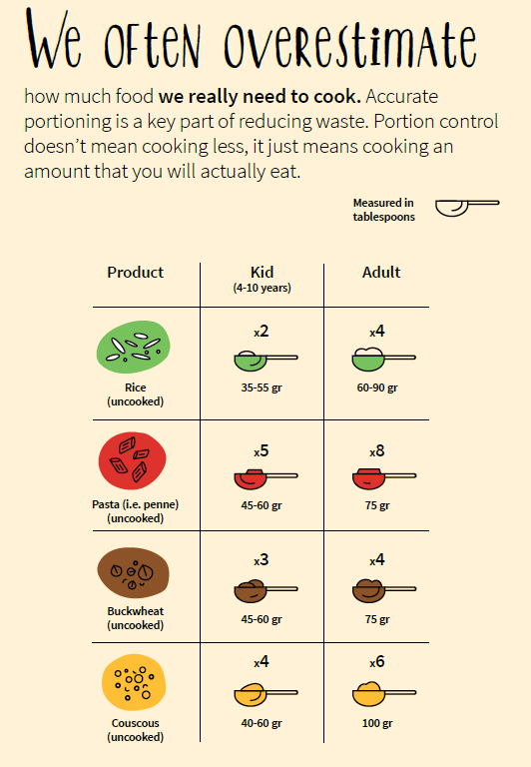

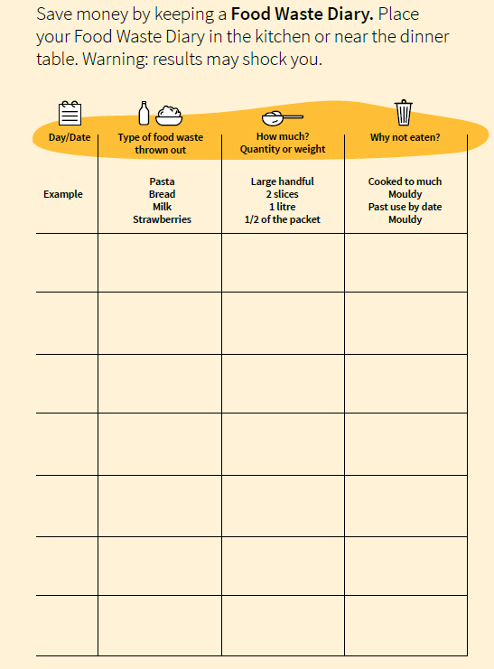

Slide 16
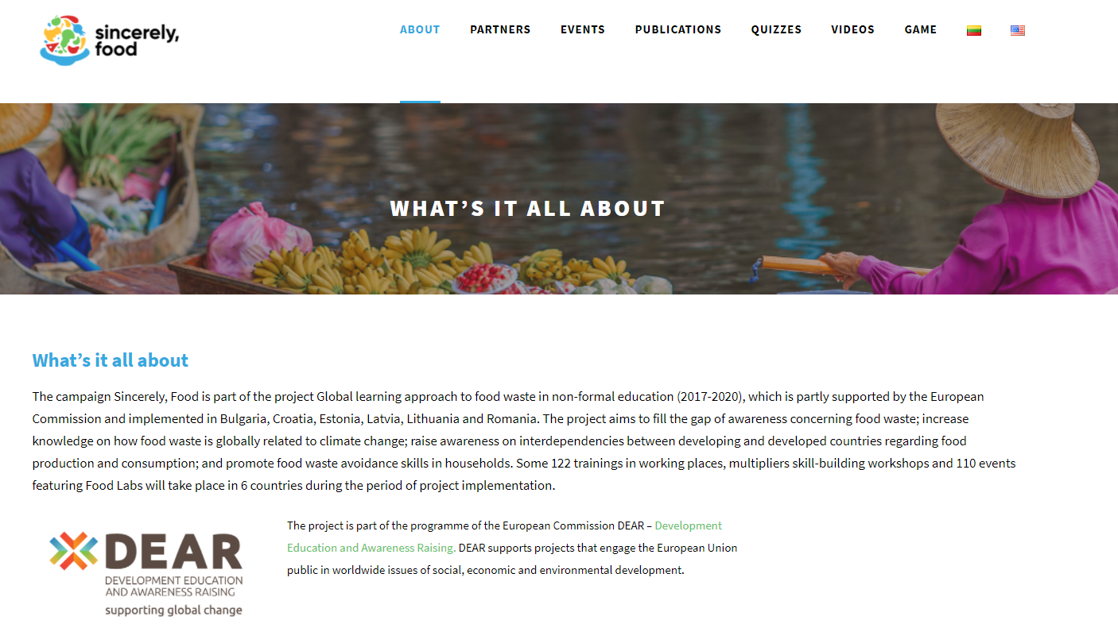
www.sincerelyfood.eu

Slide 17
Sources
FAO, 2013. Food Wastage Footprint – Impacts on Natural Resources.
FAO, 2015. Food wastage footprint & Climate change.
FAO, 2017. Save food for a better climate. Converting the food loss and waste challenge into climate action.
FUSIONS, 2016. Estimates of European food waste levels.
WRAP, 2018. Food waste measurement principles and resources guide.
Priefer C., Jörissen J., Bräutigam K.R., 2016: “Food waste prevention in Europe—A cause-driven approach to identify the most relevant leverage points for action”, Resources, Conservation and Recycling 109, p. 155–165.
Thyberg K. L., Tonjes D. J., 2016. "Drivers of food waste and their implications for sustainable policy development”, Resources, Conservation and Recycling 106, p. 110–123
"Towards a circular economy: a zero-waste programme for Europe" (COM/2014/0398 final): reduce food waste by half by 2030.
WWF & TESCO, 2021. Driven to Waste: Global Food Loss on Farms.
Thank You!

