Slide 1

IMPROVING FOOD TOGETHER
OUR IMPACT

Slide 2
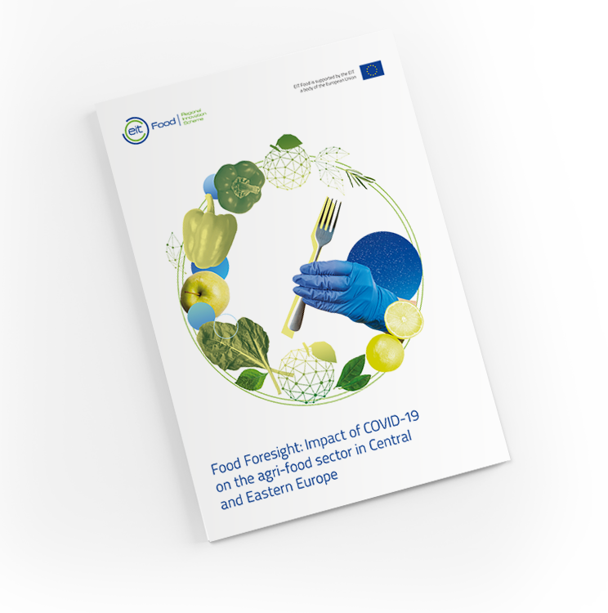
HoReCa sector proved to be most heavily negatively impacted by the COVID-19 and faced multiple challenges due to lockdowns.​
How can HoReCa implement sustainable practices in this challenging time?

Slide 3

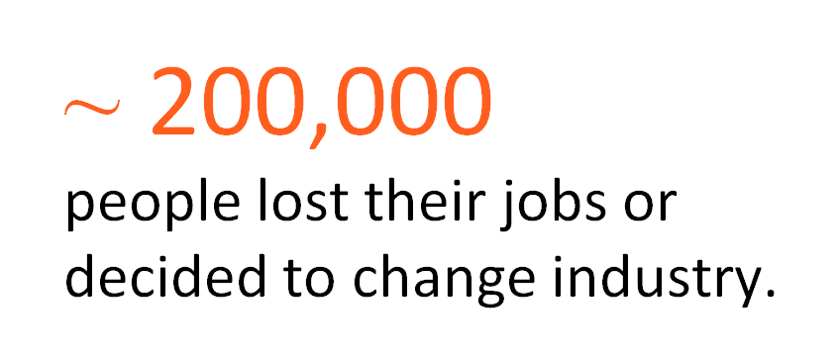
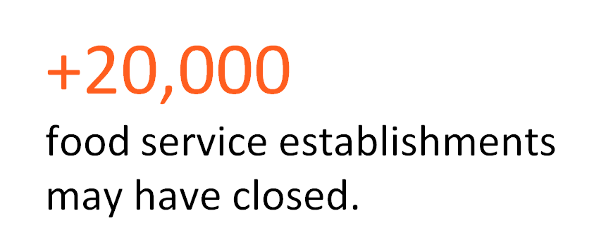
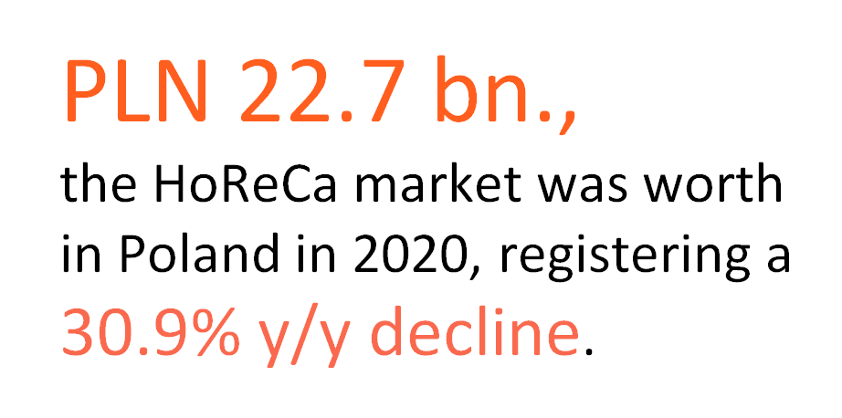
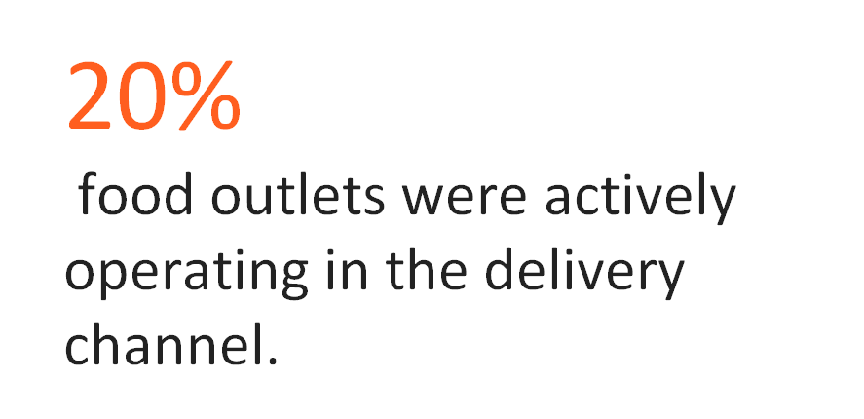
COVID-19 Impact on the HoReCa in Poland

Slide 4

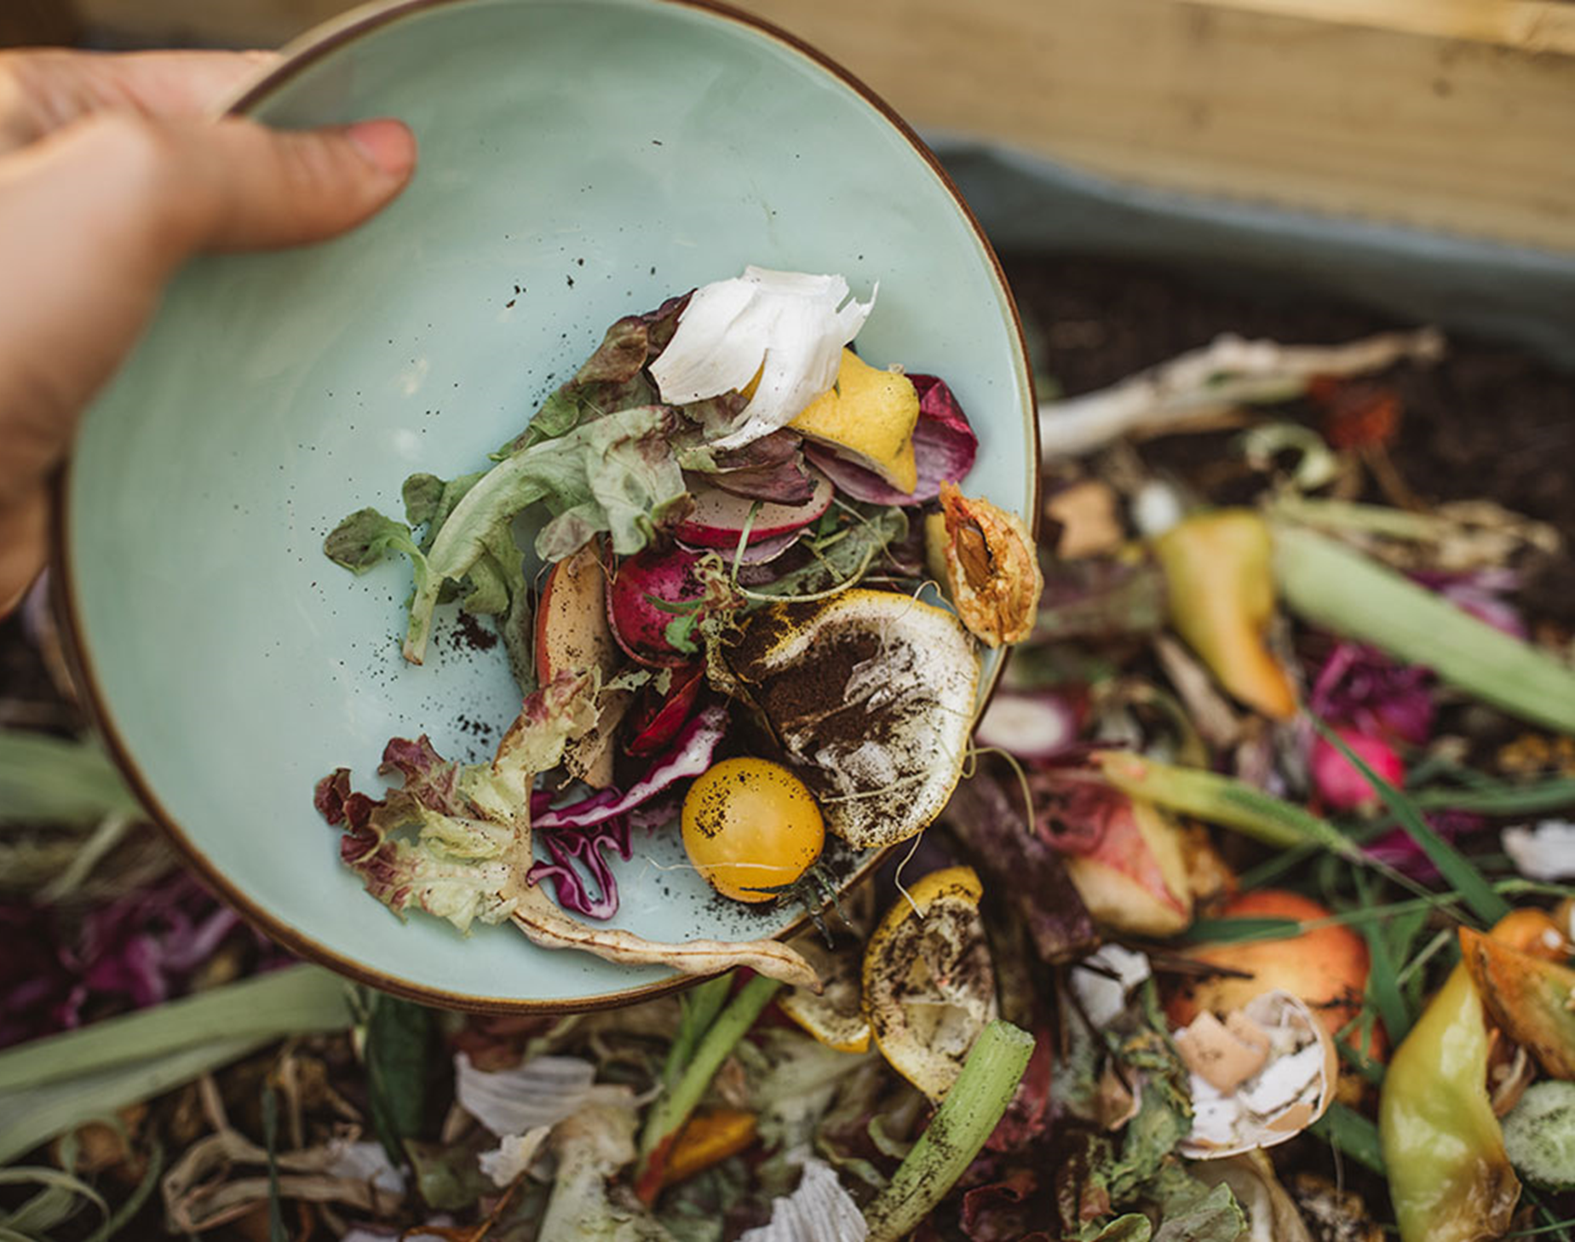
HoReCa is undergoing a major shift
COVID -19 pandemic
climate change
legal requirements concerning greater sustainability
expectations and awareness of customers are changing

Slide 5
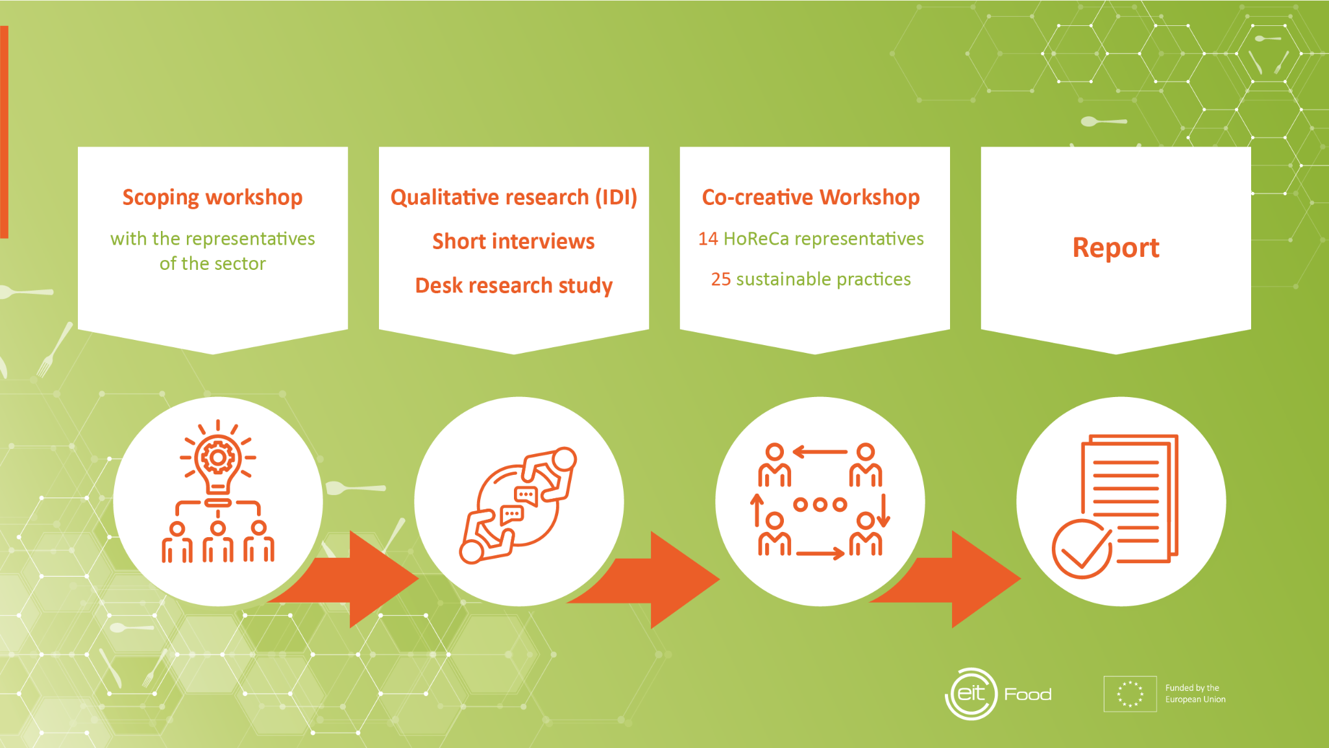
Project stages

Slide 6
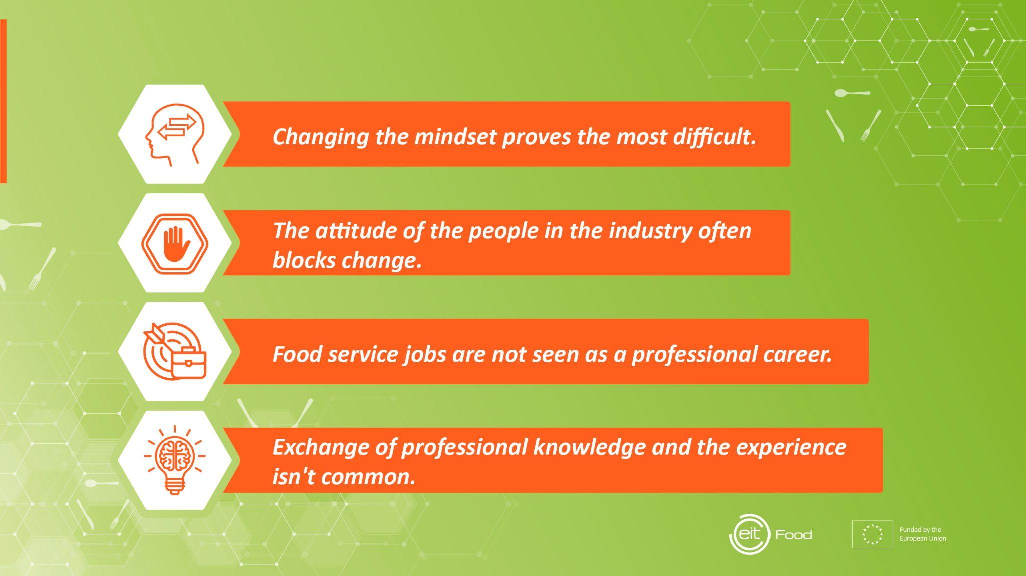
Main Insights
FOOD PRODUCTS ARE NOT
OPTIMALLY USED.
REDUCING WASTE
ALSO DEPENDS ON SUPPLIERS.
LOCAL PRODUCERS ARE NOT EASY PARTNERS.
"DATA is the NEW BLACK" but
THE BENEFITS OF NEW TECHNOLOGY ARE NOT OBVIOUS TO RESTAURANT OWNERS.

Slide 7

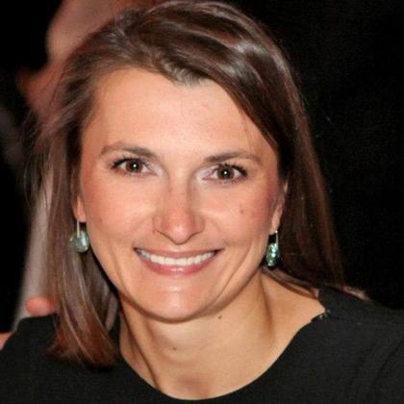
Jolanta Jurkowlaniec,
owner of the Dinette restaurant in Wroclaw
I show the path of development to my employees. There is a lot of knowledge and many directions to grow in the industry. However their families still ask them:
"When will you find a normal job?"
Working in gastronomy can be a real career, but today it is not easy to plan your path in this branch.

Slide 8
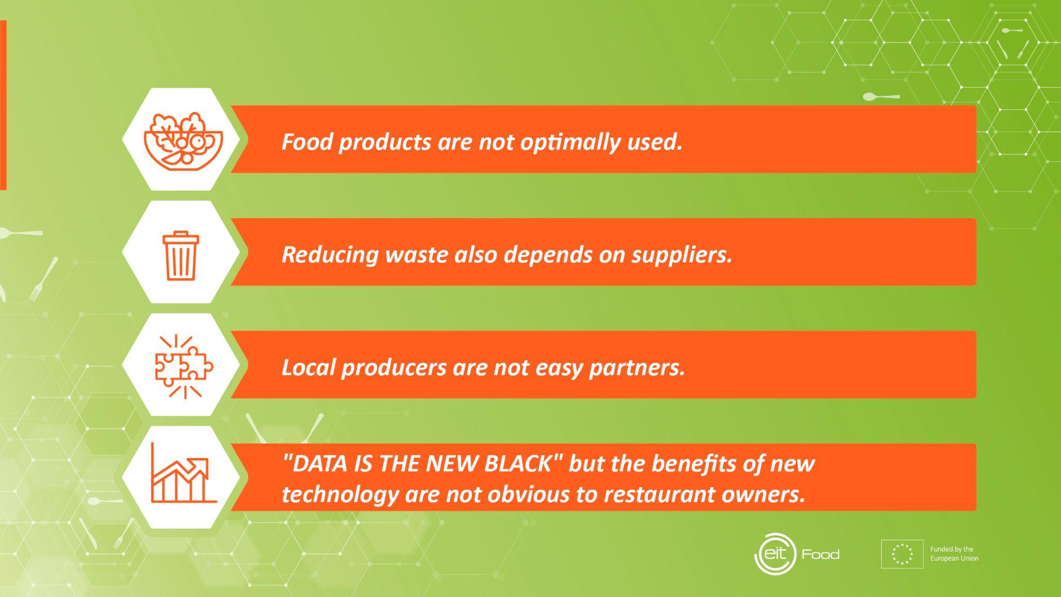
Main Insights
CHANGING the mindset PROVES THE MOST DIFFICULT
The attitude of the PEOPLE IN THE INDUSTRY often BLOCKS CHANGE
food service JOBS ARE NOT seen as a PROFESSIONAL career.
Exchange of professional knowledge and the experience ISN'T common.

Slide 9
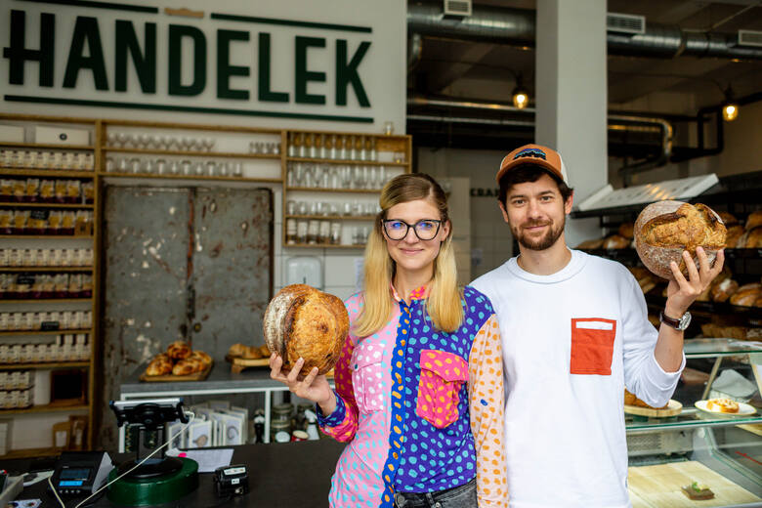
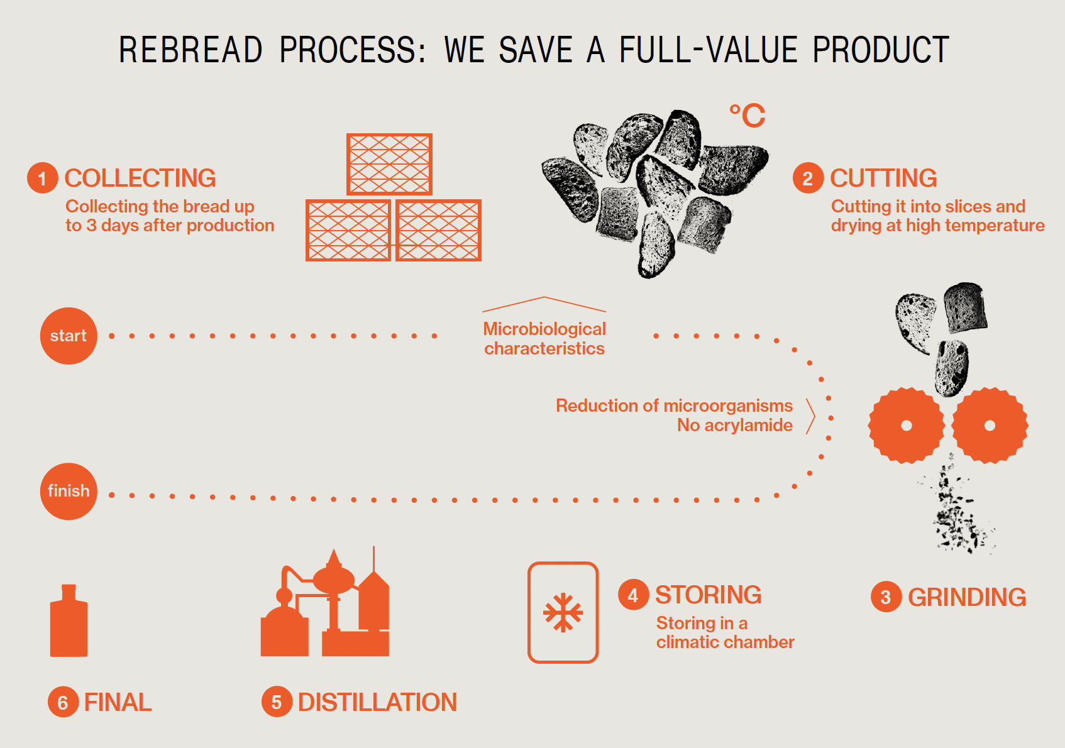
Katarzyna Młynarczyk, co-owner Rebread
Co-owner Rebread, Handelek - gastronomy concept with sustainability and zerowaste culture, which main mission is to implement circular economy in product, experiences and services.
Rebread - saving unsold, stale bread by turning it into new valuable products

Slide 10
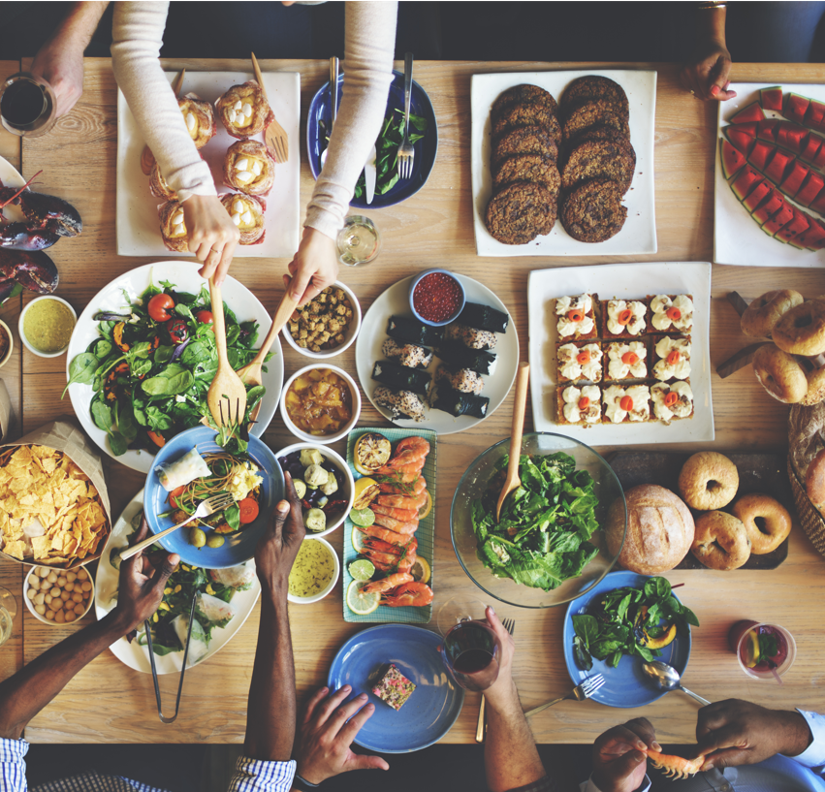

A daily break
to share
a team meal

Slide 11

Team education:
product and producer knowledge,
reducing
food waste
sustainable practices

Slide 12

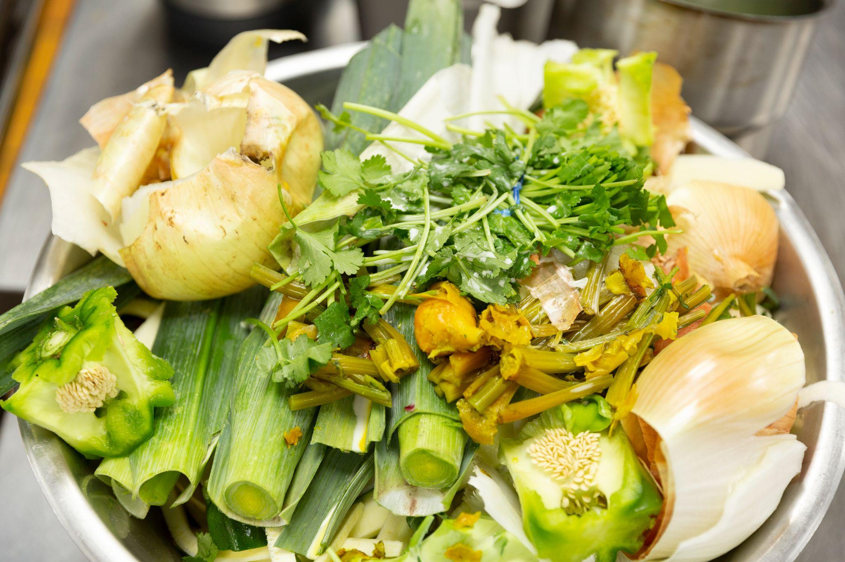
Management of waste as a material for further use
Own production of meal ingredients

Slide 13

•Building a network of cooperating restaurants

Slide 14

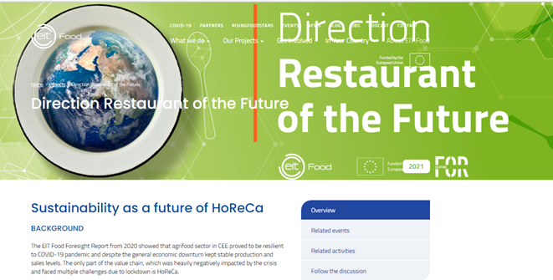
Report Direction Restaurant of the Future
The summary of the research and co-creative HoReCa representatives’ work together with the list of 25 sustainable practices
Available to download in November.

Slide 15















LET’S CREATE
THE FUTURE OF FOOD
TOGETHER!​
FIND OUT MORE AT EITFOOD.EU
Become part
of our community
Share
your ideas
Help us transform the food sector
CONTACT DETAILS
clcnortheast@eitfood.eu

