Slide 1

Future Trends of Food project
www.futureoffood.eu
Riga, 2021
Mikelis Grivins, PhD
Baltic Studies Centre, senior researcher

Slide 2
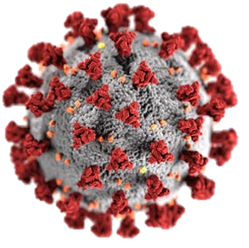
why future?
We live in a time when the future is unclear, unpredictable and it will arrive faster than we think. We will be forced to resolve challenges that we cannot even imagine at this point!
Most of us are not sufficiently prepared to structurally thing about the future. False assumptions we use results in a delusive sense of security.
why food?
Food systems are both at the giving and receiving ends of the most prominent structural shifts.
We know that food systems need to change - there are just too many challenges associated with the way how food circulation is structured in modern society.

Slide 3
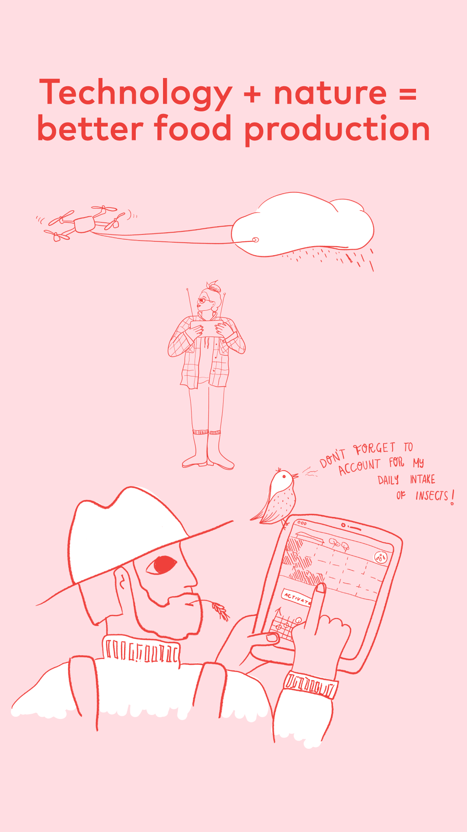
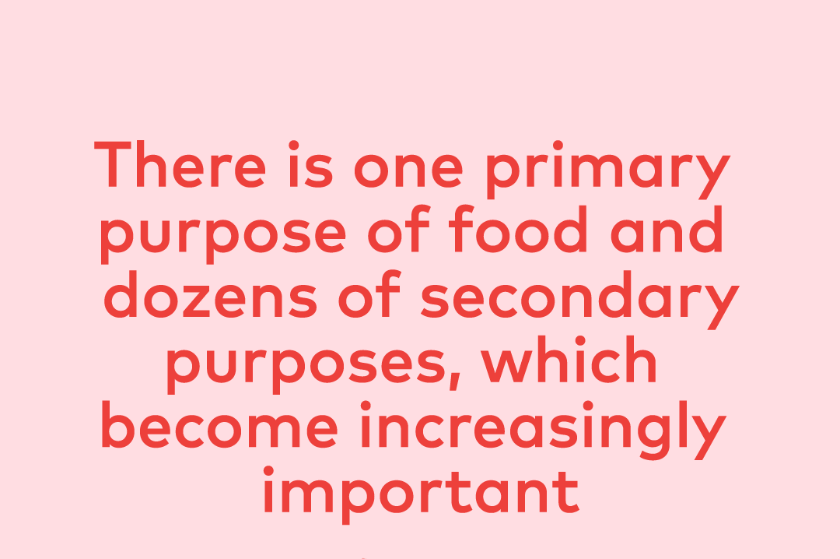
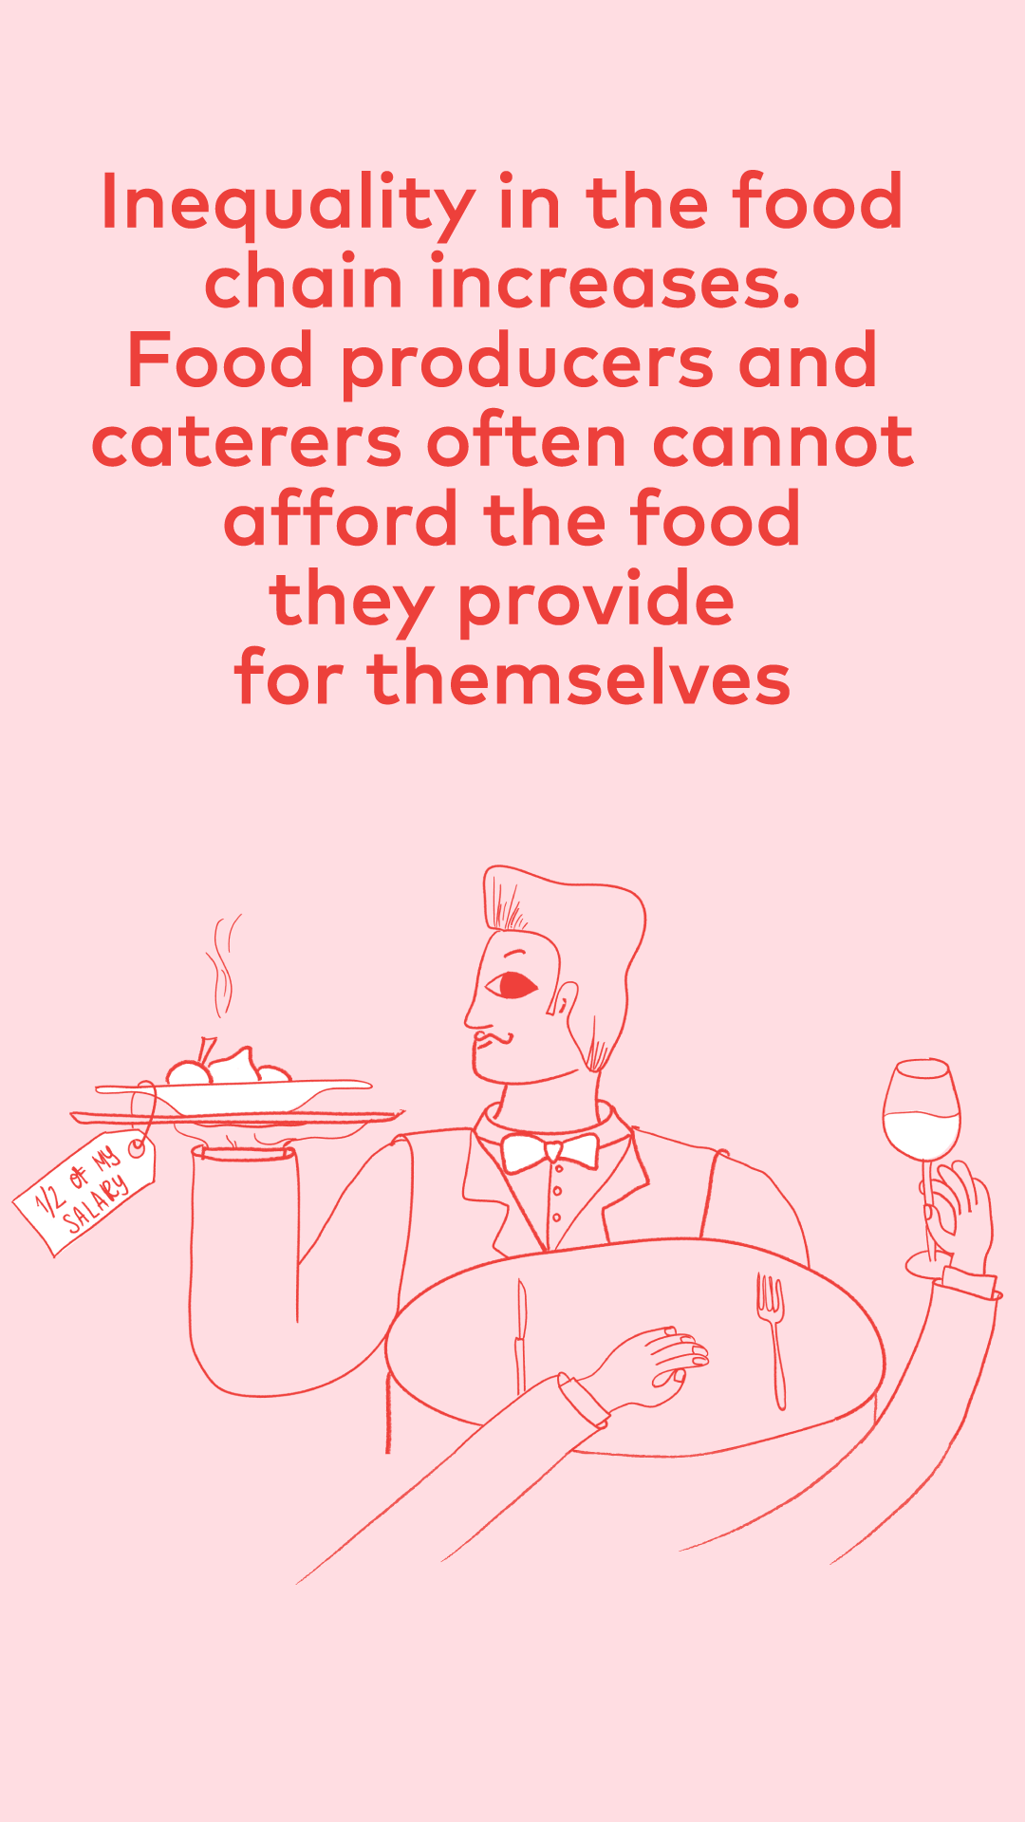
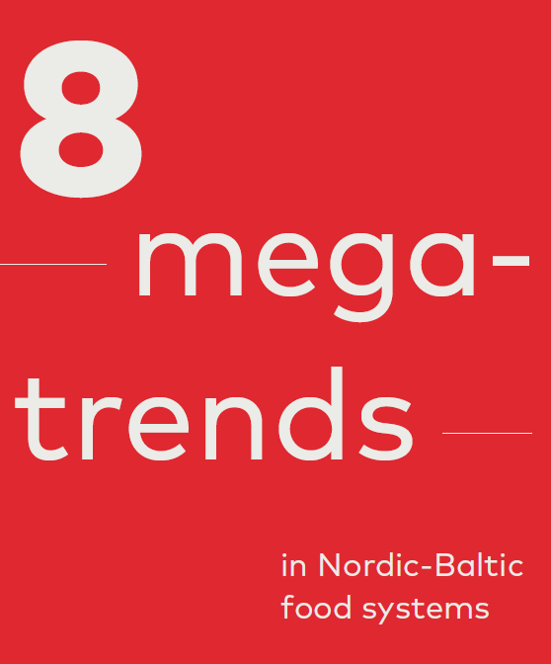
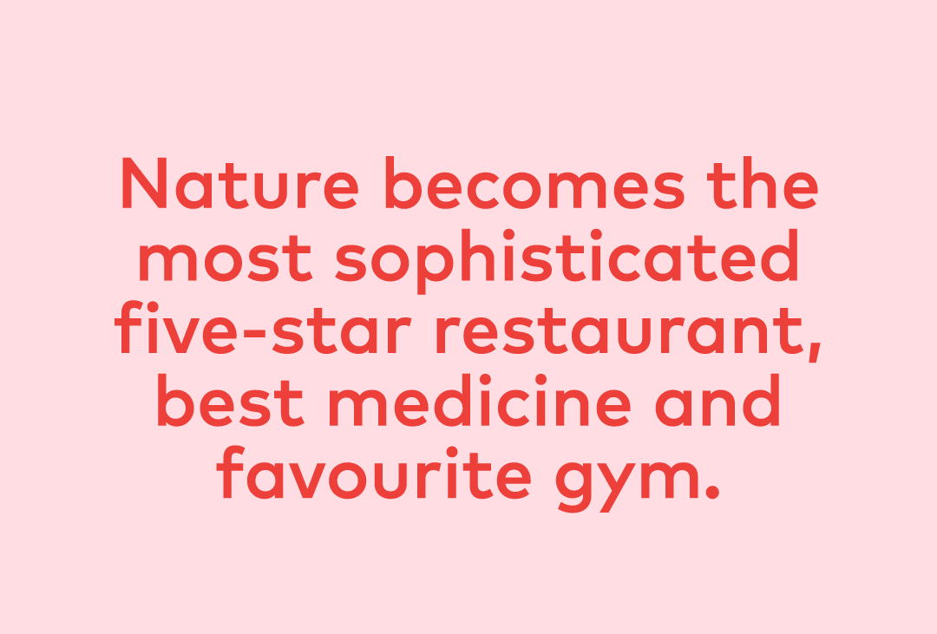
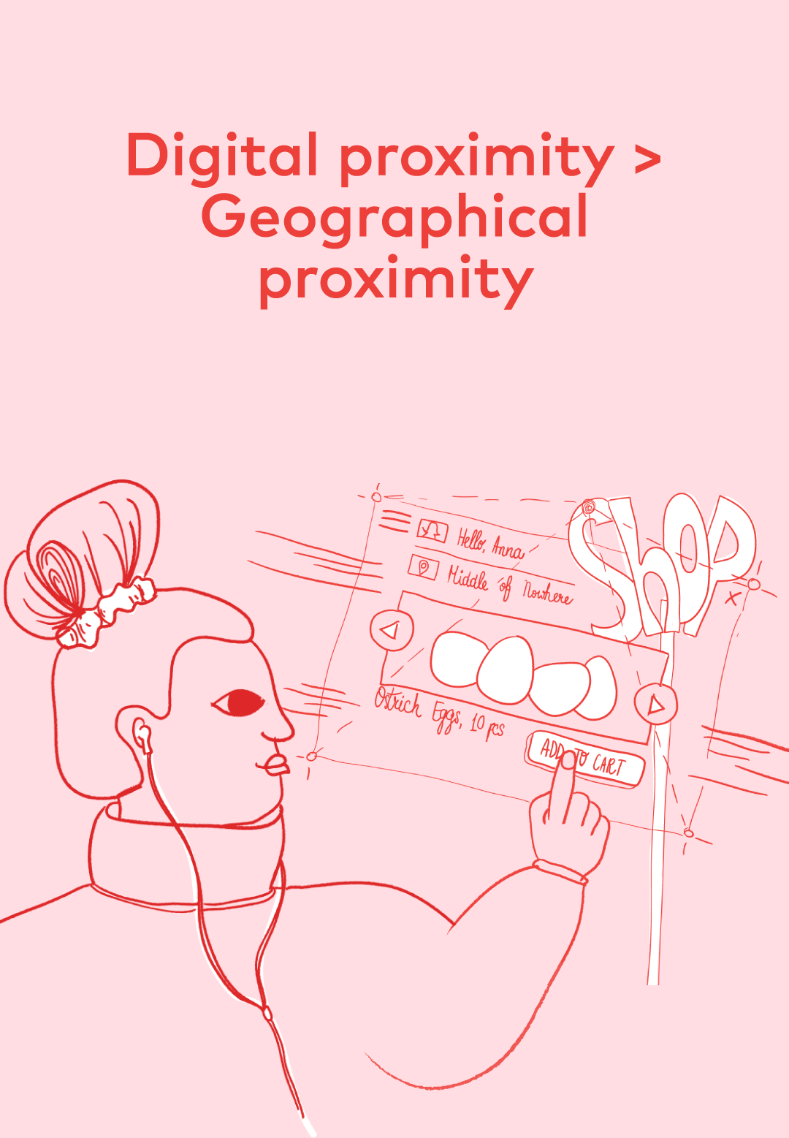
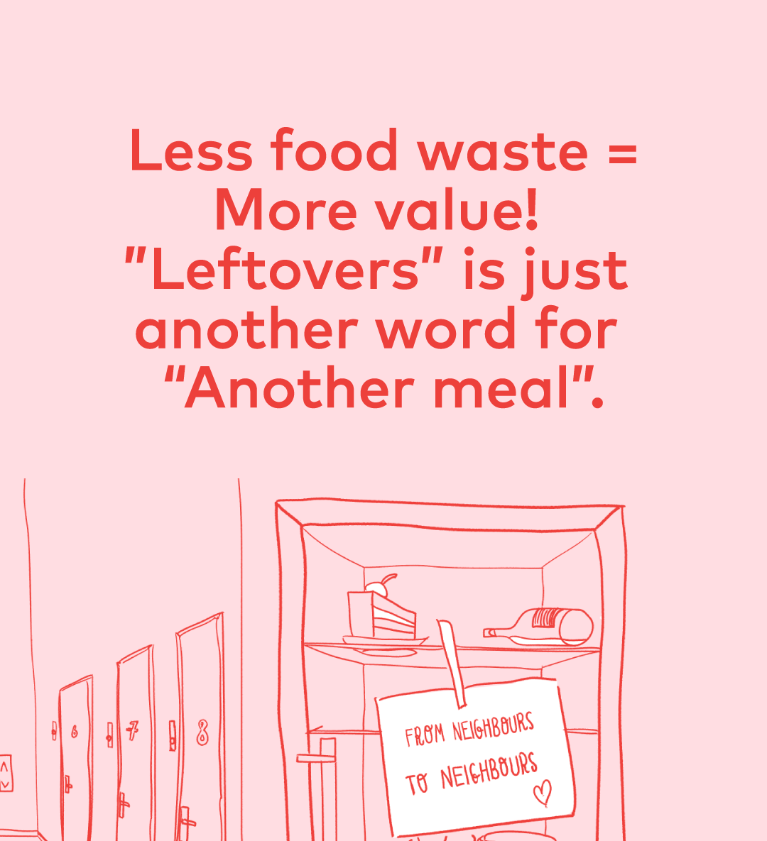
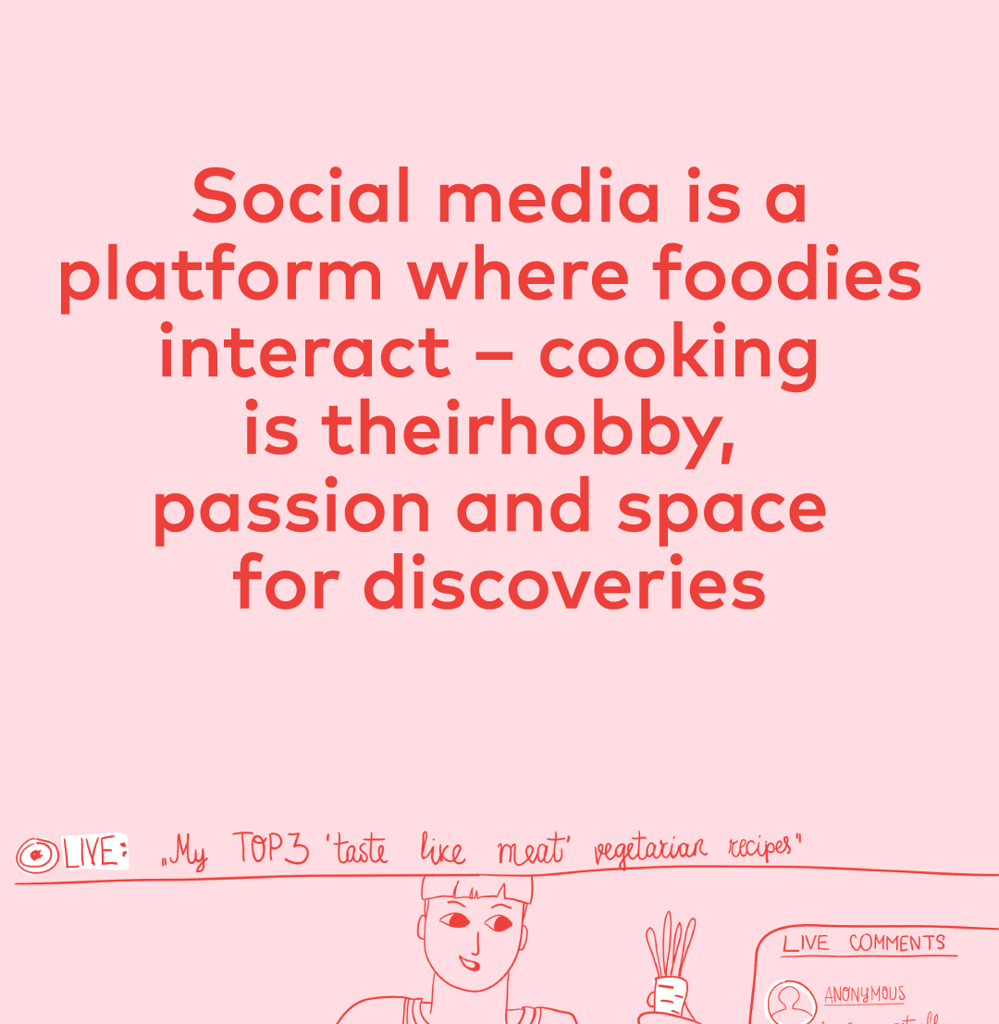
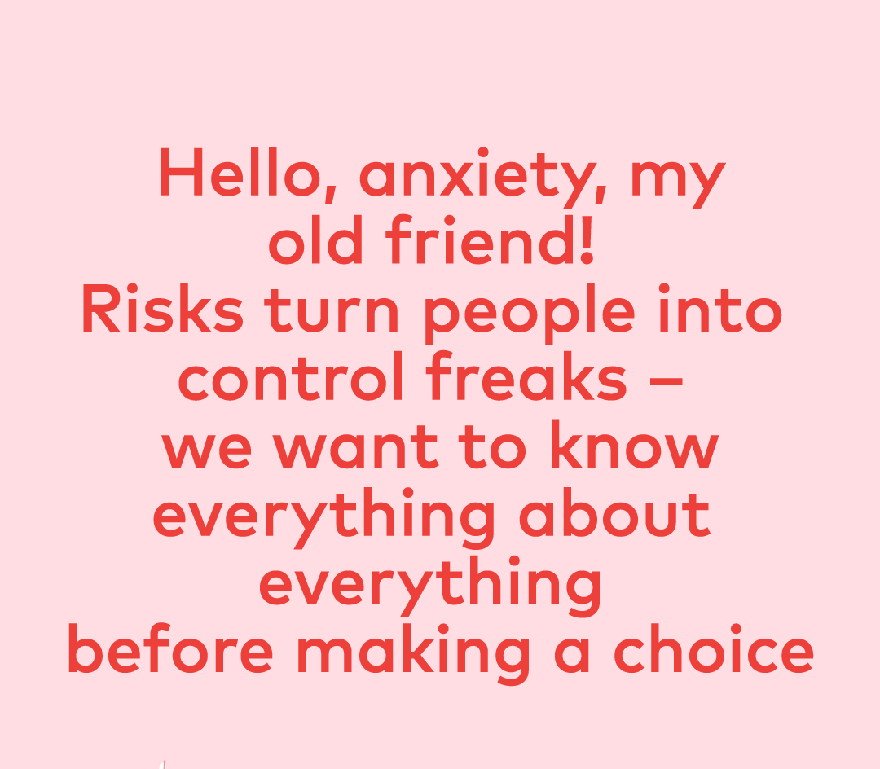
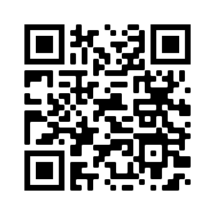

Slide 4
Which of these factors will have the greates impact…

Slide 5
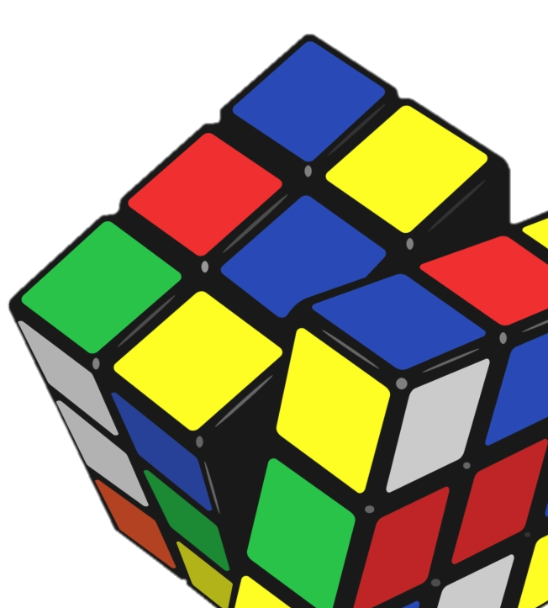
what now?
Speed of changes is increasing and, in many cases, – the scope of impacts of these changes we cannot yet comprehend. This highlights the need for new governance models that would be capable to interact with the unknown and rapid changes.
The visions of the future of the research community and practitioners differ. There is a need for instruments linking these two visions of the future.

Slide 6
Thank you!
Contacts:
mail: mikelis.grivins@gmail.com

