Slide 1


EIT Food Foresight study and food waste in Baltic Sea region
Aleksandra Niżyńska, RIS Project Manager
12.10.2021, Great Taste Zero Waste
Riga, Latvia

Slide 2
A guide to EIT Food
Use the slide from other deck

Slide 3
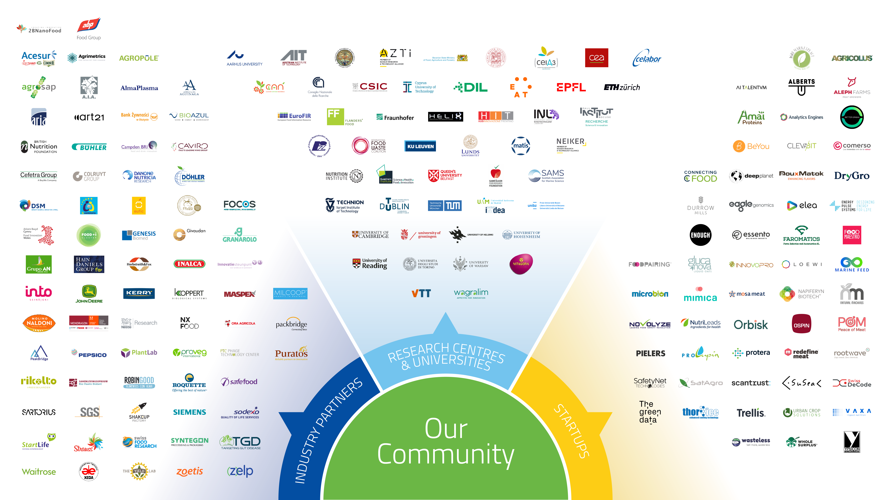
IMPROVING FOOD TOGETHER
OUR COMMUNITY
Our community is unique because it brings together key players from across the food value chain including industry partners, startups, research centres and universities
Notes:
ARt21, Aarhus University, Lund University, Warsaw University, Maspex, VTT, Packbridge, Baltic Sea Action Group, EAT Foundation
Startups: Napiferyn (PL), Natufia (EE), Agroplatforma (Latvia)

Slide 4
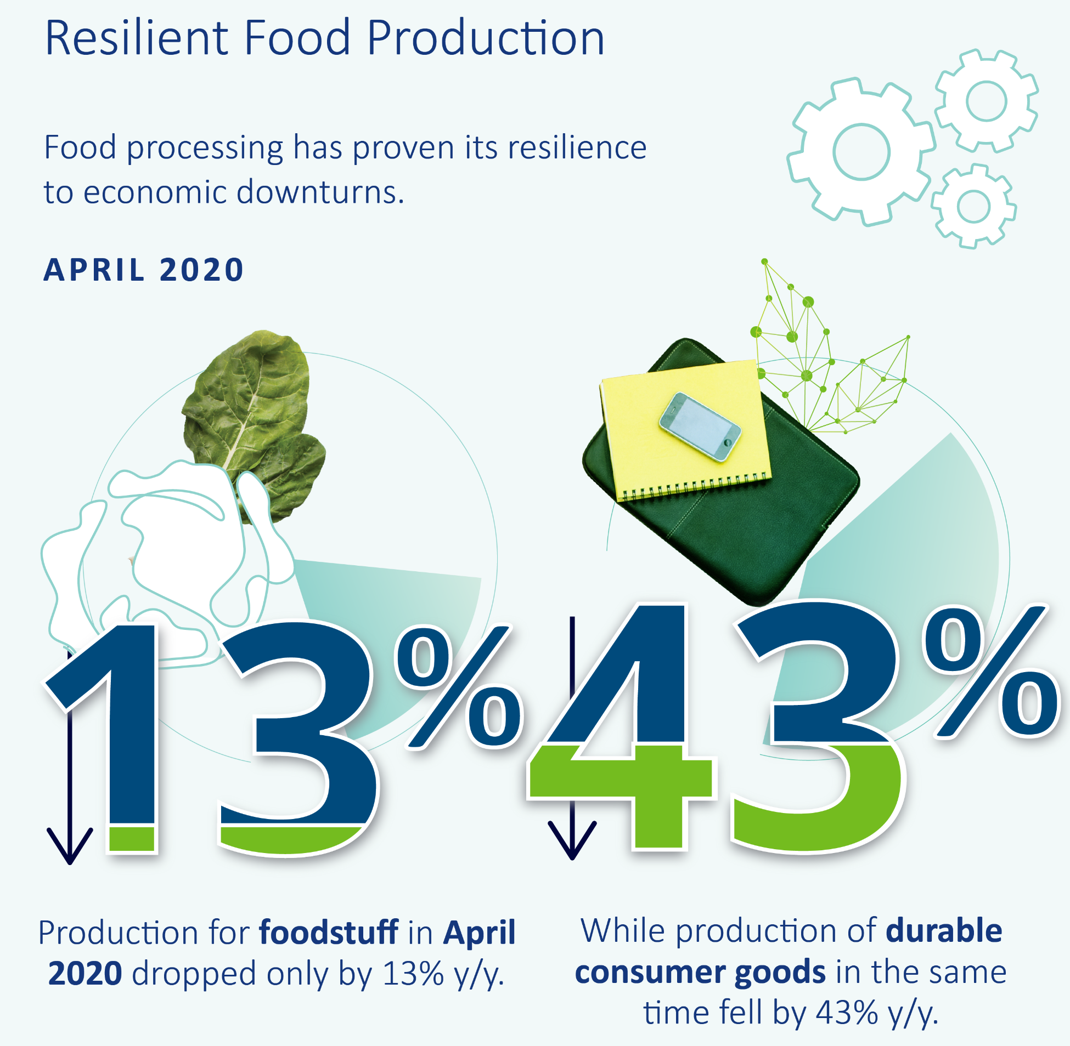
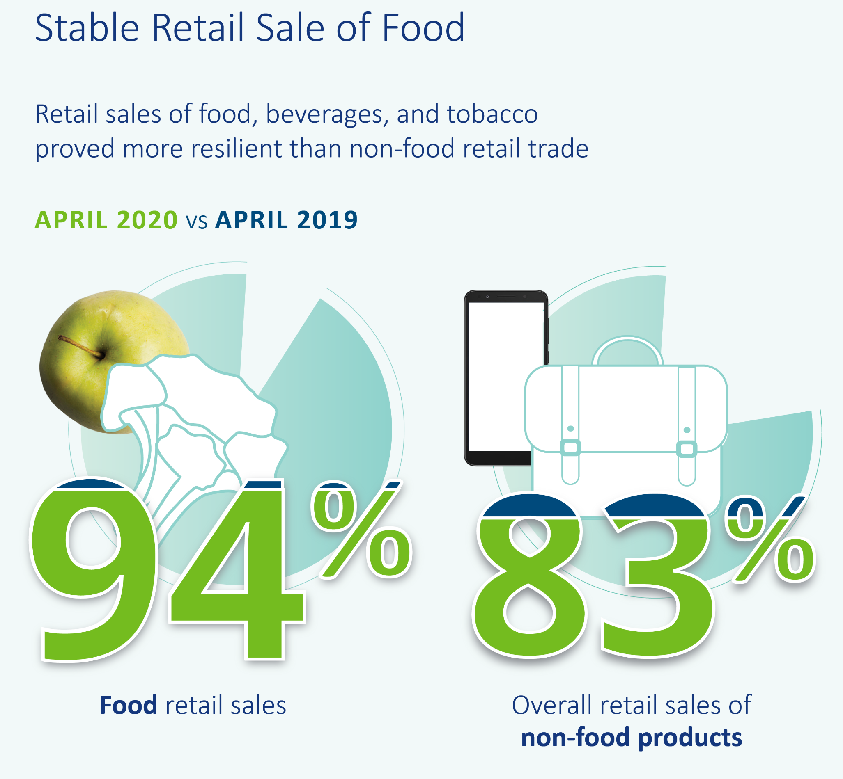
Situation of Agrifood sector in CEE during the pandemic first wave
Notes:
In Latvia: Manufacturing of food and beverages performed slightly better or similarly to other domestic industries and CEE peers
Consumer demand for food products fell by 3% but rebounded to 102% level of the previous year in July. Sales of food, unsurprisingly, were not severely impacted and demand was around its usual levels. The retail sales of non-food products, while initially lagging behind due to certain restrictions, were able to quickly catch up and outpace the food sales.
In Estonia: In manufacturing output, Estonia managed to remain above average in nearly all categories of March and April. In July, it can be also observed that it was able to recover well in capital goods and non-durables, and it underperformed in terms of food and durable goods production. Retail sale of goods in Estonia also proved to be resilient enough to withstand the blow of the pandemic. Overall retail trade (not including vehicles and motorcycles) and retail sale of non-food products were the only categories to fall significantly below 100% y/y in April. Categories which included the sales of food and beverages did not grow in this period, but also were not significantly harmed and remained well above the regional average. What is more, specialised stores noted a large growth in the period between May and July (reaching 136% y/y, compared to CEE’s 97% y/y).
In Lithuania: Following very good manufacturing results, retail data looks slightly less optimistic in the first months of the pandemic. Across the board in all categories in March and April, Lithuania scored below the region’s average. Sales of both food and other goods in those months dipped equally to around 80-90% of the previous year’s results. However, Lithuania was able to recover in a short amount of time to later achieve higher than average growth in retail sector in July (around 4-5% higher in all categories).

Slide 5
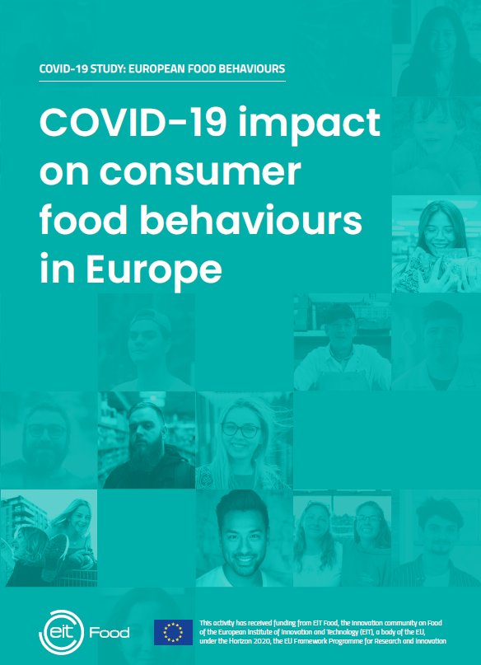

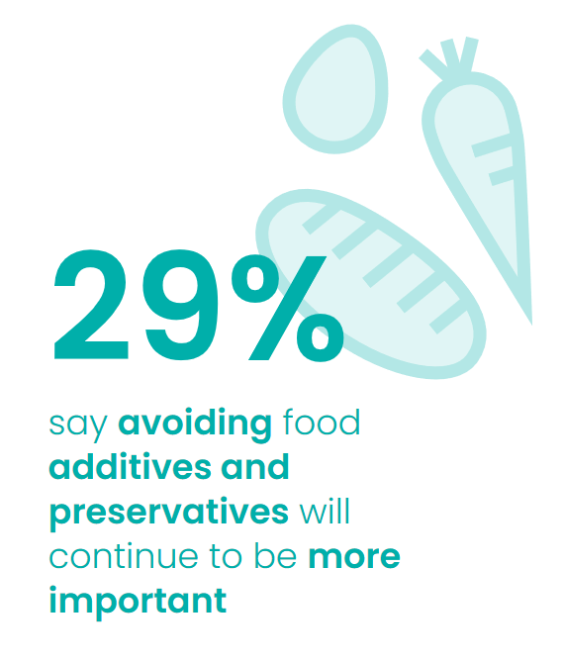
People plan to buy more local food and reduce unsustainable packaging and food waste
CAWI, 10 countries (Spain, Sweden, Germany, UK, Poland, Italy, France, Greece, Finland, Romania), 17-25 September, sample 500 consumer per country, total 5000 consumers
Notes:
45% of consumers said they were planning purchases more carefully vs just 7% less.
Overall more than half of people surveyed changed their behaviour around unplanned shopping and these changes were quite polarised, with 28% reporting less impulse purchases (as high as 40% in Greece) and 23%
reporting more (as high as 39% in Romania).
Of the 44% that threw away less food, just 37% of these say they are very likely continue (plus 11% reported throwing away more food and 60% of those plan to persist with this).

Slide 6
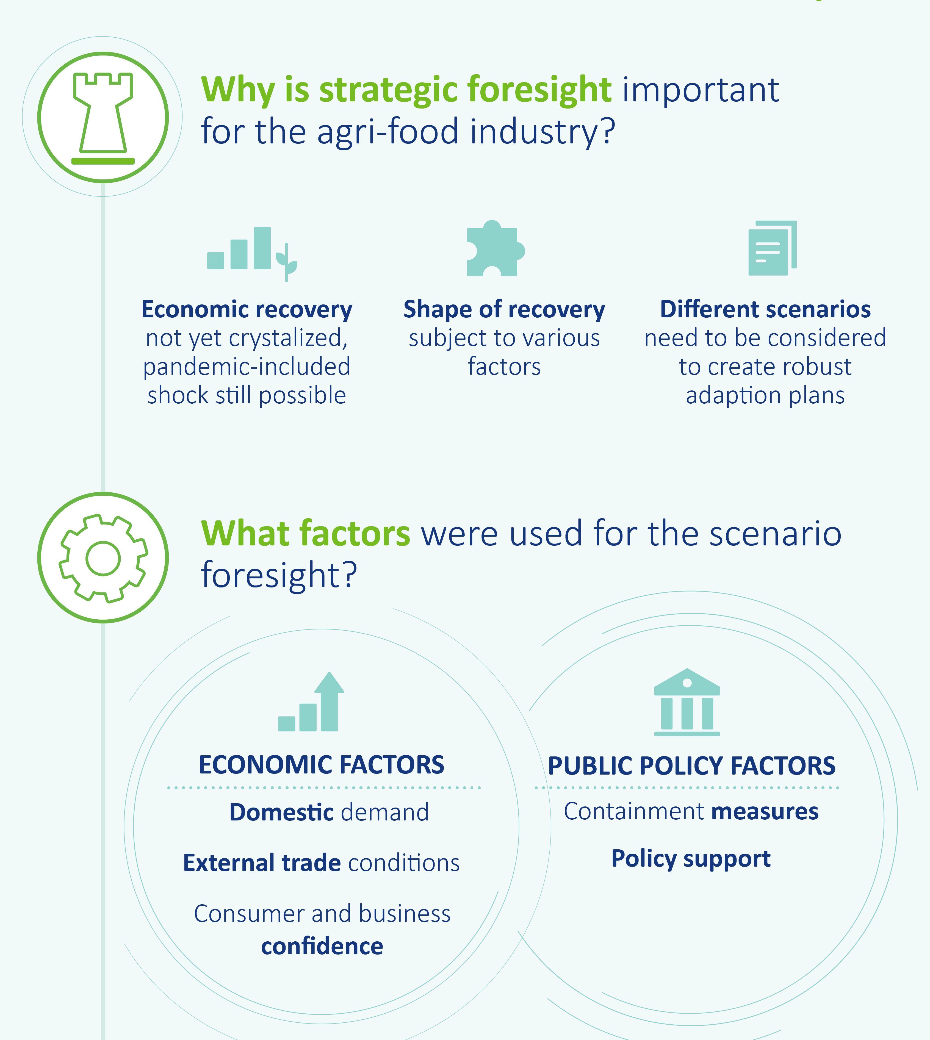
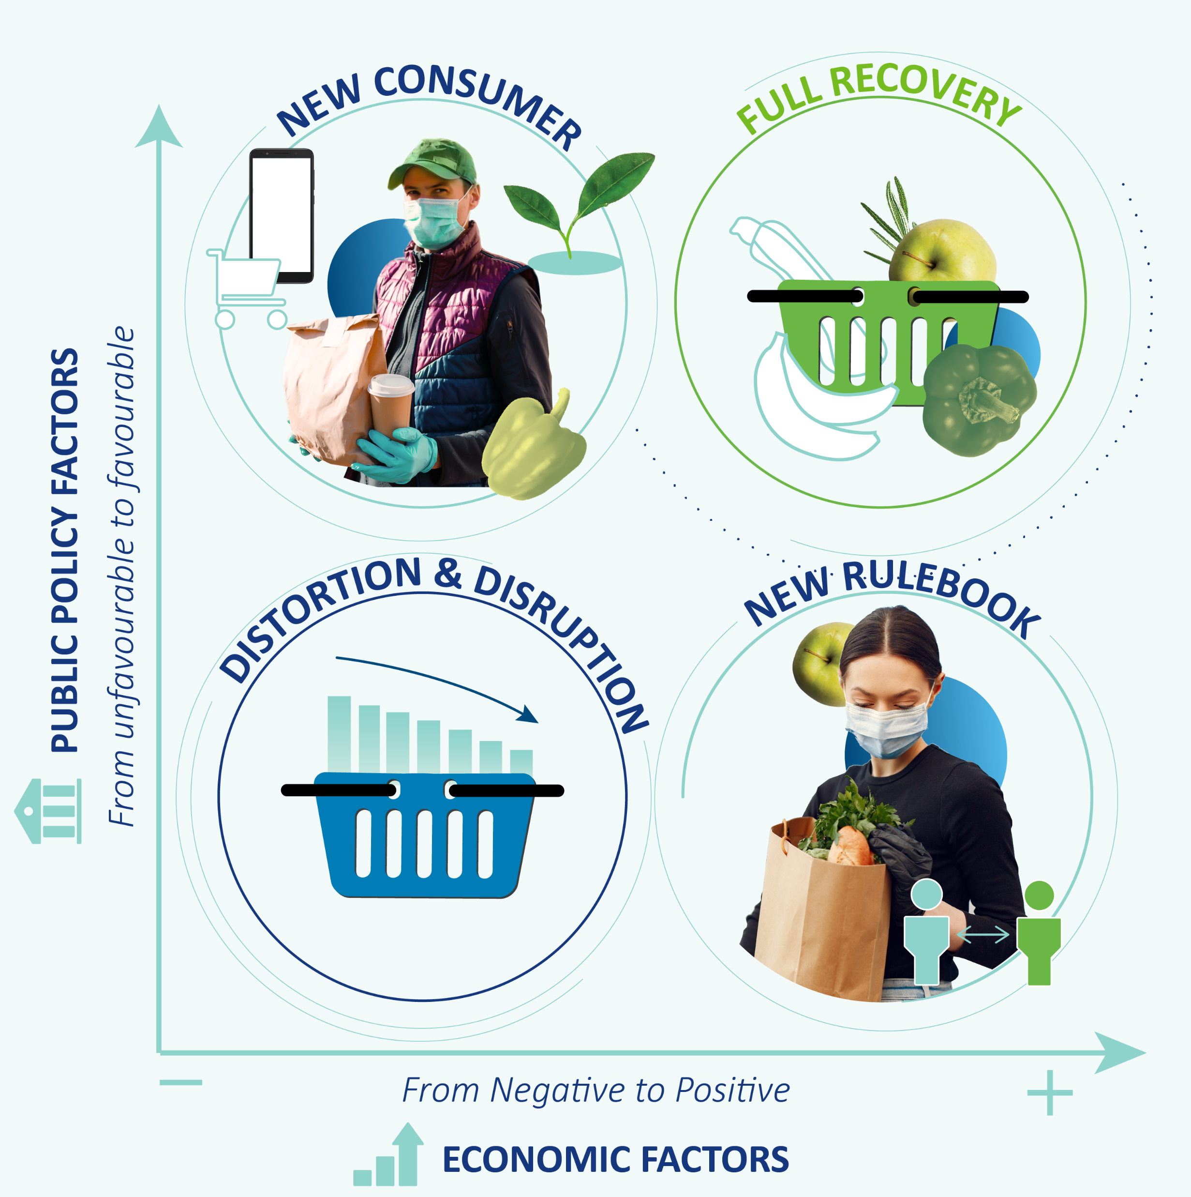

Slide 7
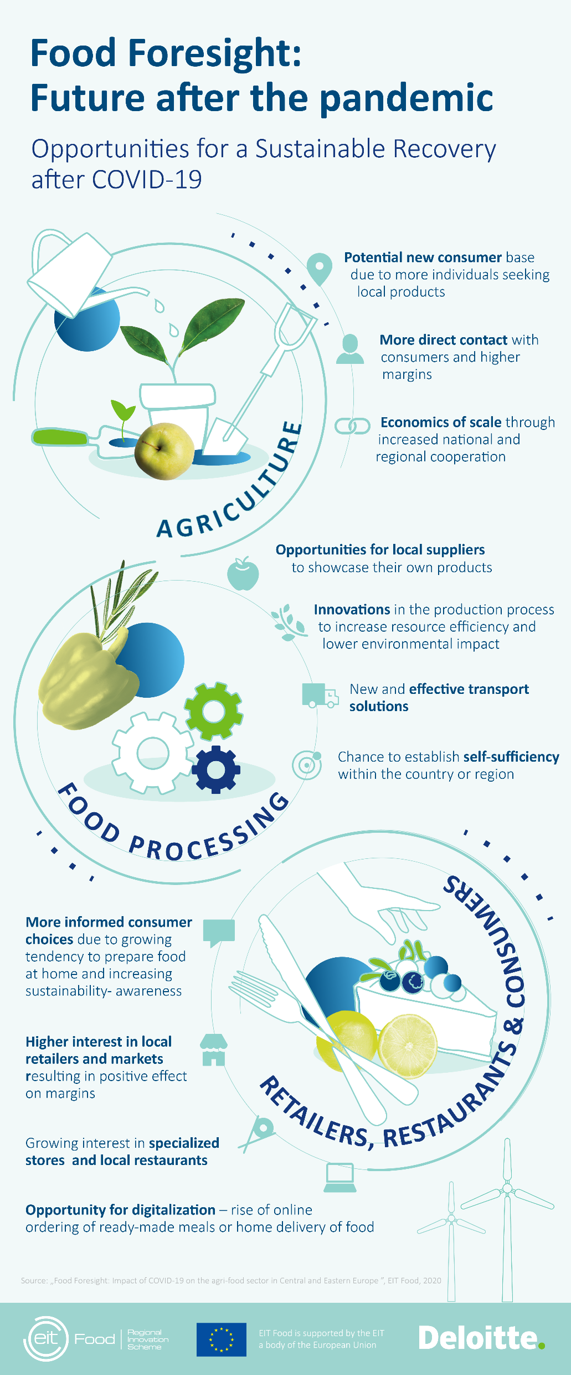
Future after pandemic – opportunities to reduce food loss
LESSONS LEARNT FROM THE BALTICS
Baltic Bubble – creation of the Single Baltic anti-virus area
Stable fast lanes for essential goods incl. food - solution to avoid losses for agricultural and food producers for which long-term storage of their products is not possible
Notes:
In the case of Latvia, the consequences of COVID-19 for agricultural and forestry producers were
made significantly worse by restrictions on the crossing of Latvian-Lithuanian borders and by the
fact that for quite a long period of time, border crossing, including for agricultural and food freight
transport, was possible only through three crossing points on the Latvian-Lithuanian border. Due
to the closure of Latvian-Lithuanian borders, Latvian producers had to face significantly increased
transportation costs, even though fuel prices decreased. Latvia calls for cross-governmental
solutions in crisis situations to be accelerated to avoid losses for agricultural and food producers
for which long-term storage of their products is not possible.

Slide 8
Future after pandemic – opportunities to secure food safety
LESSONS LEARNT FROM THE BALTICS
Increased fish import - Baltic states reported increased fish import from Sweden and Norway
Boom for frozen and canned fish sales – certain types of fish used predominantly by restaurants subject to significant decrease in demand. The solution was freezing and canning, especially during the relatively short period which proceeded the lock-down
Notes:
Baltic states reported increased fish import in 2020 compared with the
previous year.
- In Estonia, imports of all fisheries products increased by 13% in January-
July 2020;
- Lithuanian imports had 12% increase;
- Latvian imports had 10% increase.
- Main suppliers were Sweden (20 percent) and Norway (15 percent). The
main product imported was fresh salmon from Norwegian fish farms. This
product is processed in Lithuanian factories, for re-export to the EU market,
especially Germany and Italy.
- Sales of fresh salmon continued growing during COVID-19 months, and no
major setbacks were observed

Slide 9
Future after pandemic – opportunities to make more aware food purchasing decisions
LESSONS LEARNT FROM THE BALTICS
Increased planned purchase - Poland is in the top three for reported increases in planned purchases and shows the second largest decrease in ready meals.
Online groceries – increased food preparation at home and rise in online ordering and home delivery of food.

Slide 10
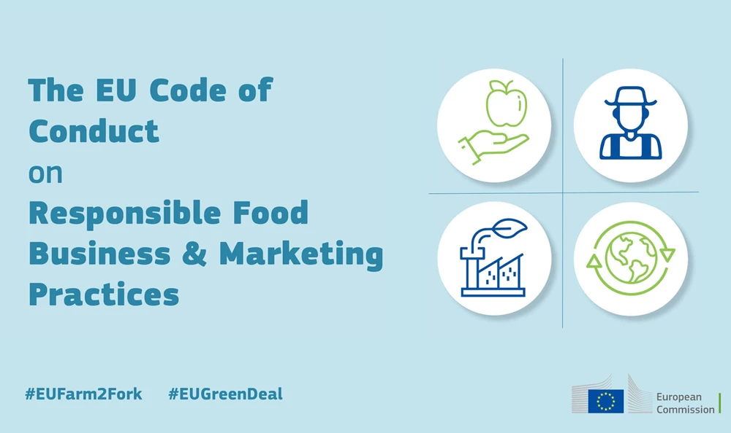
Opportunities for agrifood sector connected with EU Green Deal
Preserving food affordability thanks to fostering competitiveness, promoting short supply chain and boosting entrepreneurship
Emphasis on circular bio-based economy and organic production is a big potential for new stream of revenue for farmers
Fight with food waste - 3R approach requires avoiding any losses at all elements of food supply chain
Promotion of healthy food and reduction of consumption of highly processed food rich in additives and conservatives
Notes:
Code of Conduct Food Services – EU ()

Slide 11
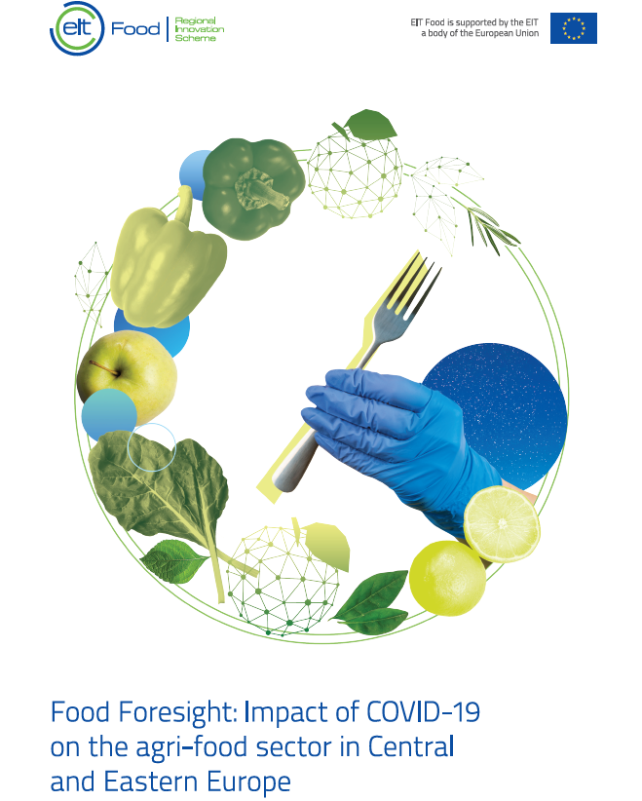
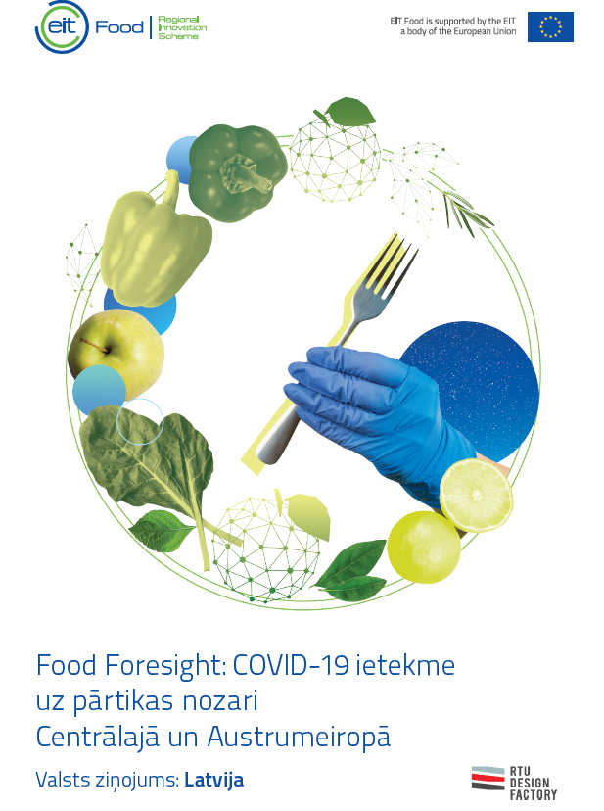
Download the report!
http://eitfood.eu/foodforesight
1 CEE Report and 12 Country reports in English and local language versions!
Bulgaria
Czech Republic
Croatia
Estonia
Hungary
Latvia
Lithuania
Poland
Romania
Serbia
Slovakia
Slovenia
More info:
aleksandra.nizynska@eitfood.eu

